Slide 1
Ritual Techniques:
New Openings in Ritual and Liturgical Studies
IRiLiS, Ad multos annos!

Slide 2
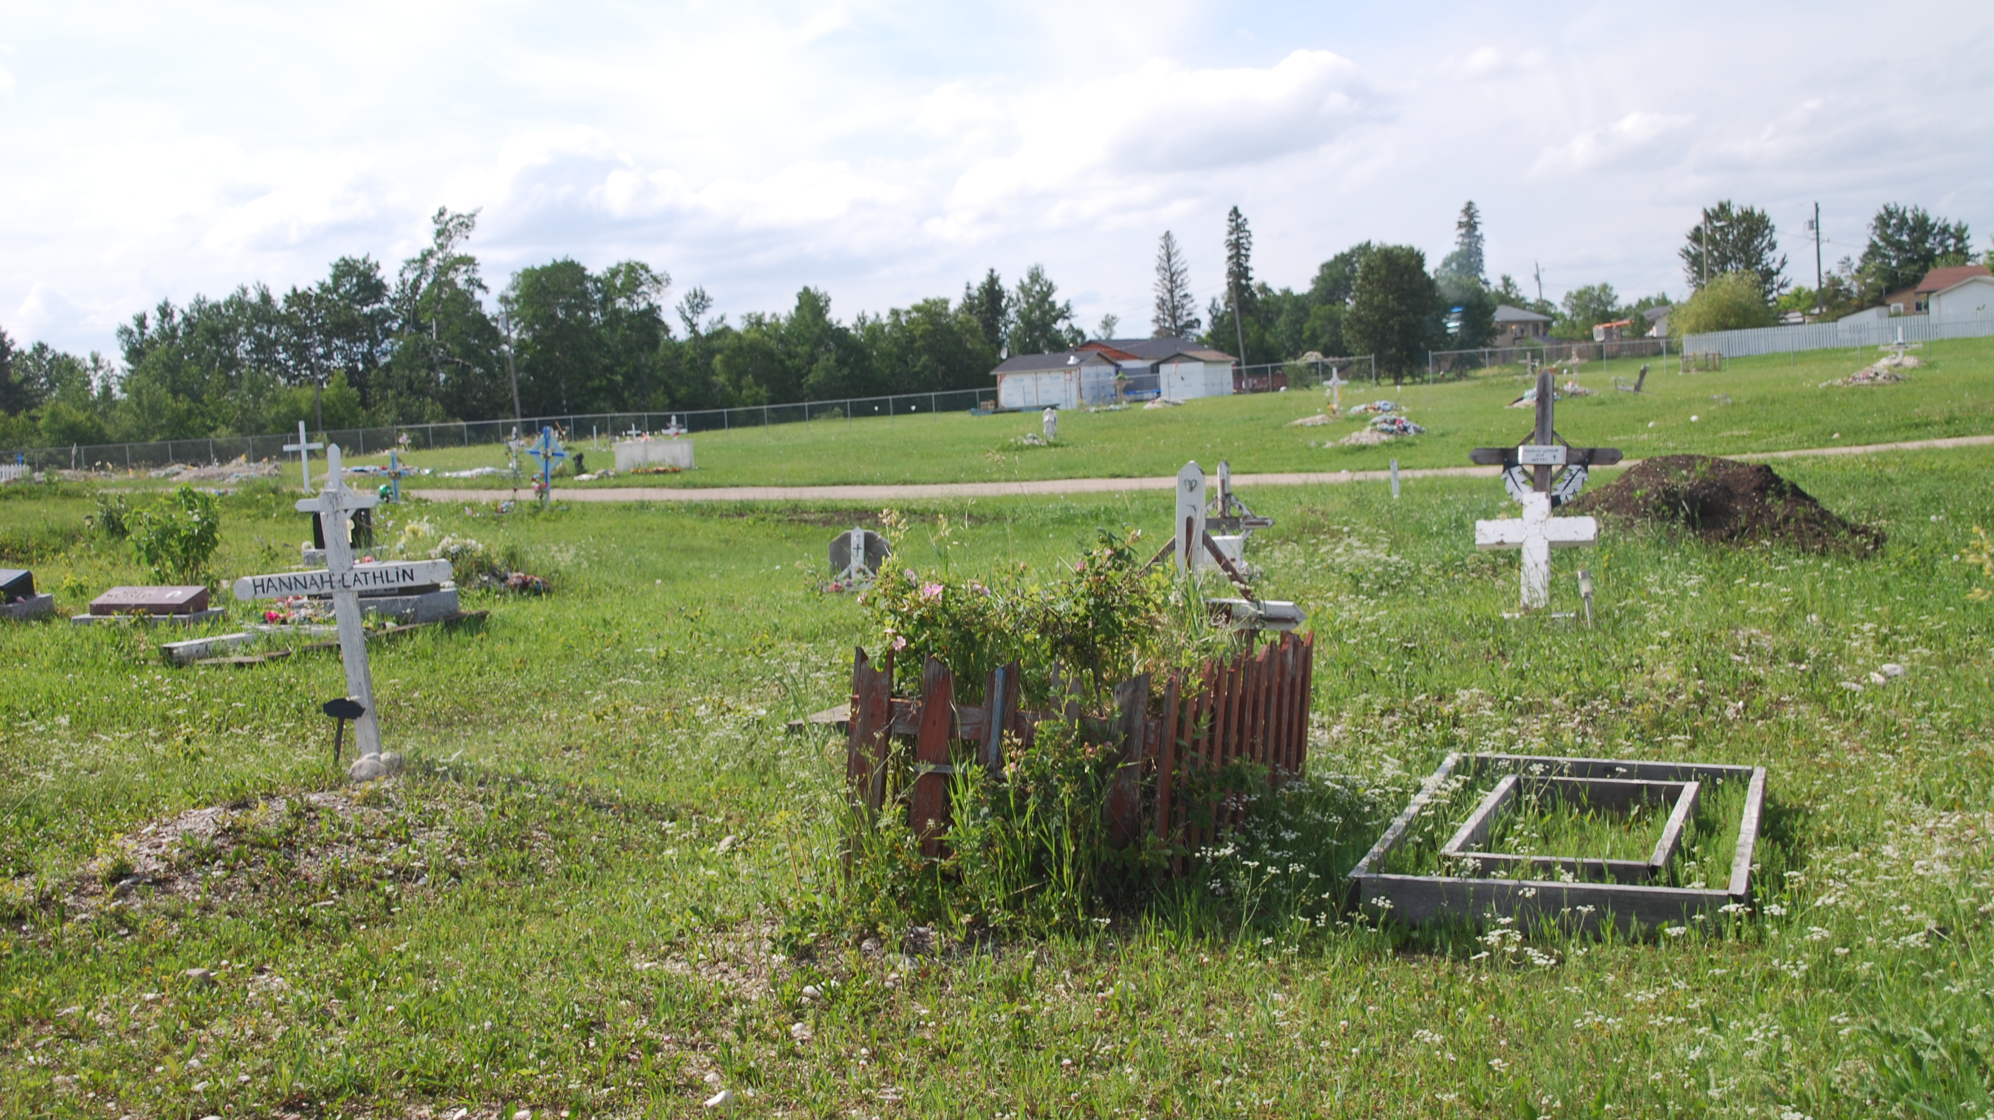
The Juxtaposition of Ritual Worlds:
Maintaining Relationship in Anglican Indigenous Christian Funerals

Slide 3
To begin:
Thanks to those from whom I have learned about indigenous Anglicanism:
  The Rt. Rev. William Cliff, Bishop of Brandon, MB
  The Venerable Rosalyn Kantlaht’ant Elm, Archdeacon in the Diocese of Huron, ON
A conversation between patterns of liturgical inculturation
      AND
Lived expressions of faith, grief, and ritual process amongst the Swampy Cree of Manitoba

Slide 4
Liturgical Inculturation
Anscar J. Chupungco, OSB
(1939-2013)
How do we interpret the call of Vatican II to adapt the liturgy to the lived realities of worshiping Catholics?
“inculturation is the incarnation of Christ, carried out by the church as Christ’s body located in myriad human cultures, that serves as the basis for both the identity and the diversity of the liturgy as the church’s self-expression.” (Mark Francis on Anscar Chupungco)
Adaptation
  A (liturgy) + B (culture) = A’
  In which the liturgy is slightly adapted through assimilation or substation in discrete ritual elements
Acculturation
  A + B = AB
  In which culture and ritual sit together without any deeper integration
Inculturation
  A + B = C
  In which both are changed-new expressions for the whole church

Slide 5
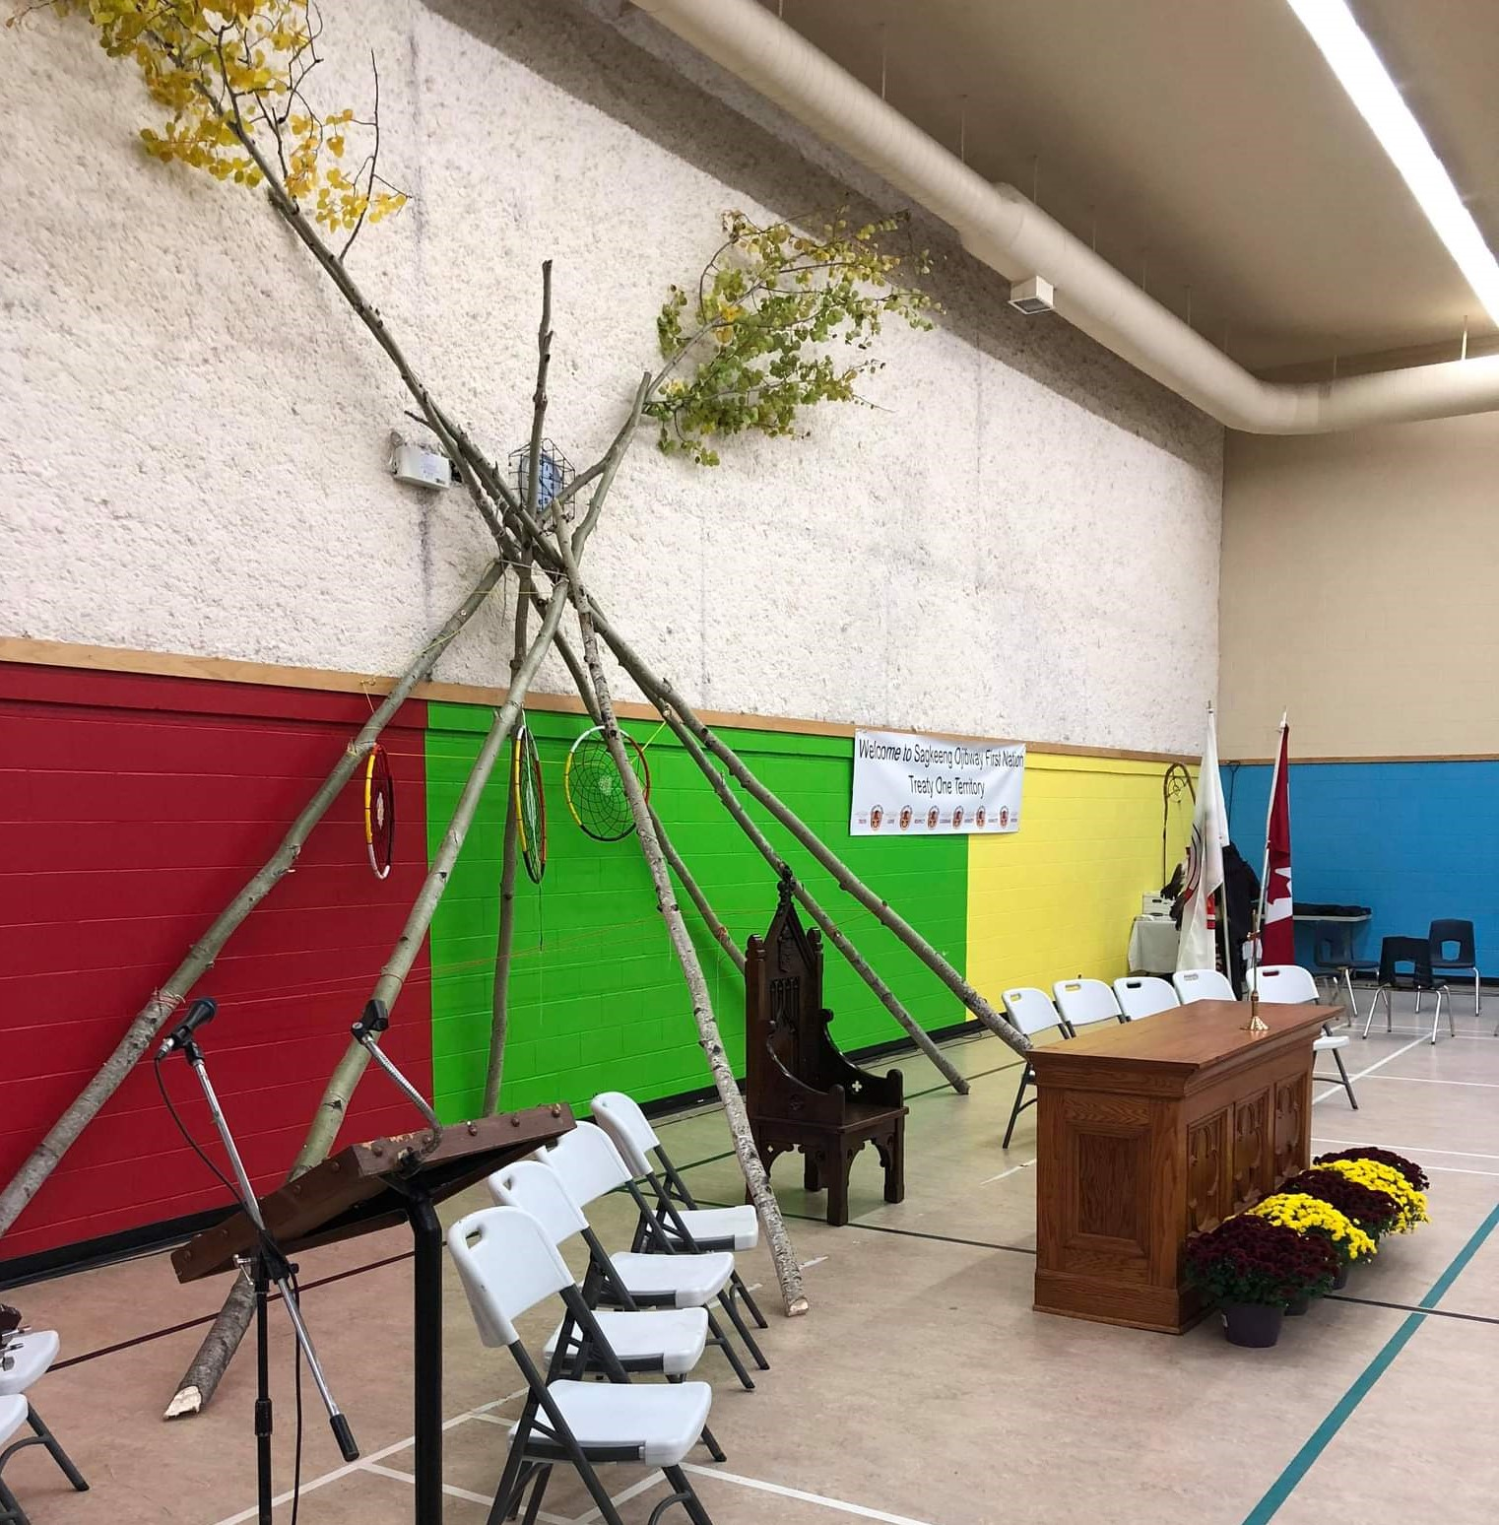
While many would consider this equation rather simplistic today, I would like borrow the basic concept to suggest that acculturation - in which the liturgy (or the ritual pattern of the universal/national church) and the local church culture remain side-by-side - is not always a stepping-stone to ‘full inculturation’, but rather may actually be the preferred ritual pattern, a ritual technique to continue two identities in the midst of diversity

Slide 6
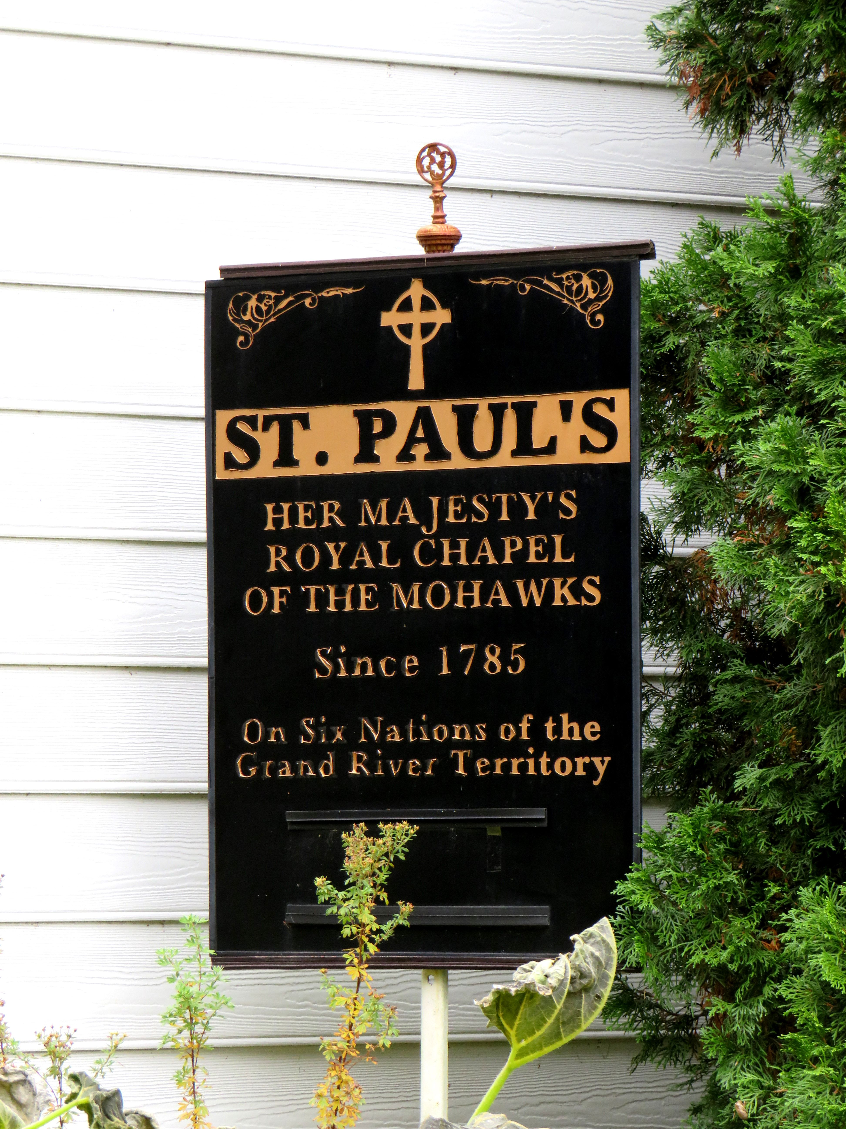
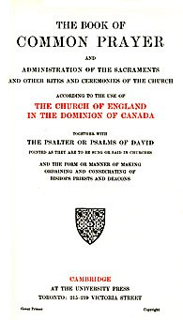

Slide 7
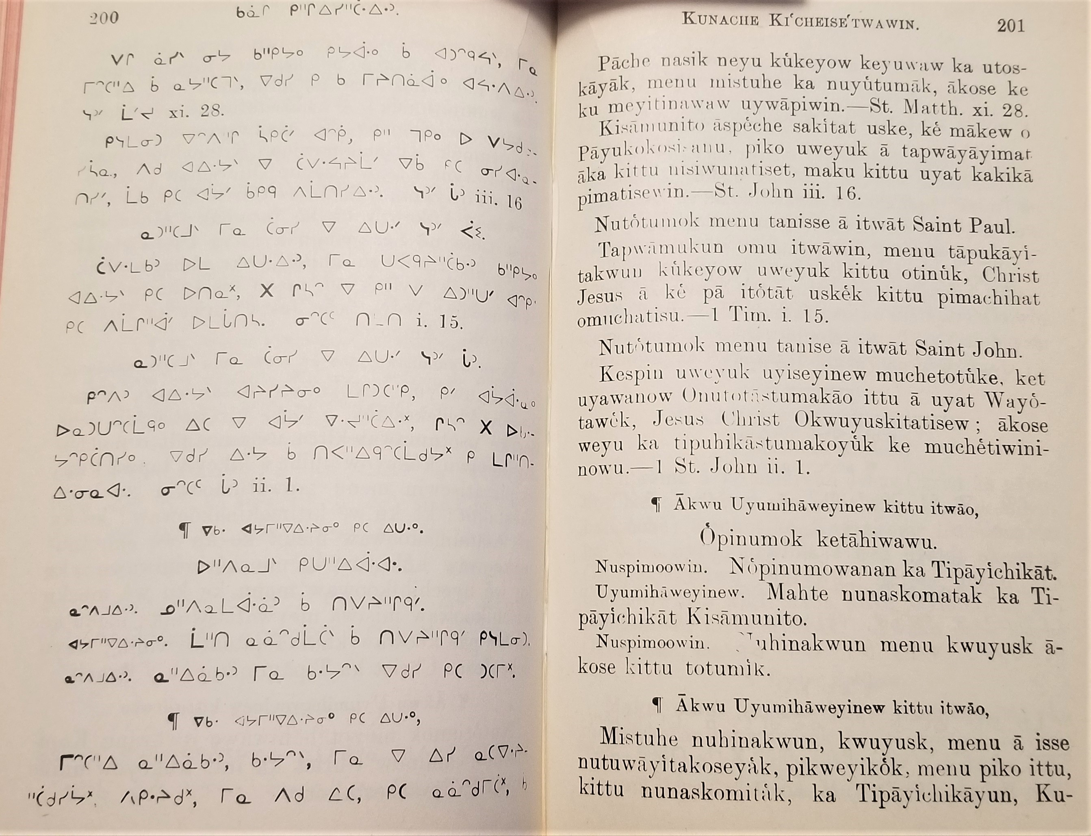
Cree Prayer Book (sursum corda)

Slide 8
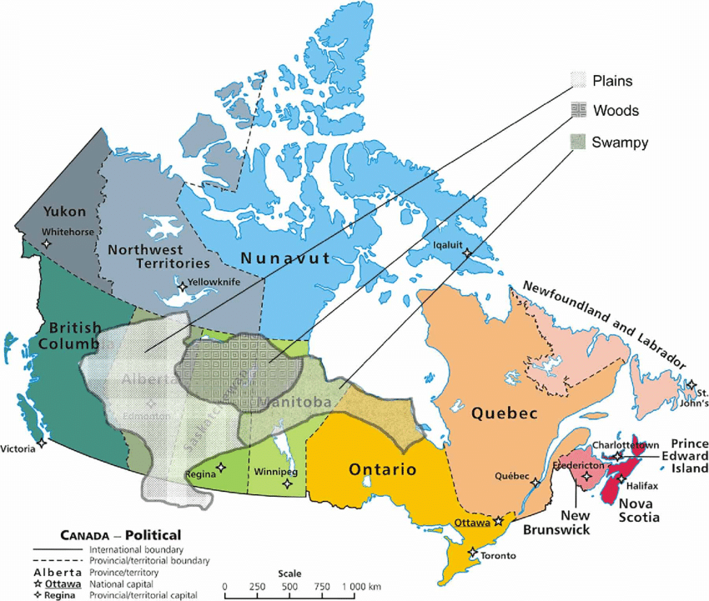
The Swampy Cree (Mushkego) are a large group within the Cree Nation, examples here from the Opaskwayak and Chemawawin bands in northcentral Manitoba

Slide 9
Burial Rite, 1962 BCP – Cree burial traditions
Procession to the church, led by priest, with scripture verses
Psalms 90, 121 & 130 (or Ps 23)
I Corinthians 15:20-58
Apostles’ Creed
Lord’s Prayer, V/R, collects
Procession to the grave with scripture, collects
Casting of dirt on body
Prayers and blessings (resurrection on the last day)
Extending time to be present through the grieving process with the family (two-night wake in the presence of the body)
Touching the body, prayers, hymn singing, testimonies, silence
Second night, priest celebrates holy communion in the presence of the body
The third morning, when the elders say it is time, the coffin is closed and the BCP burial rite begins

Slide 11
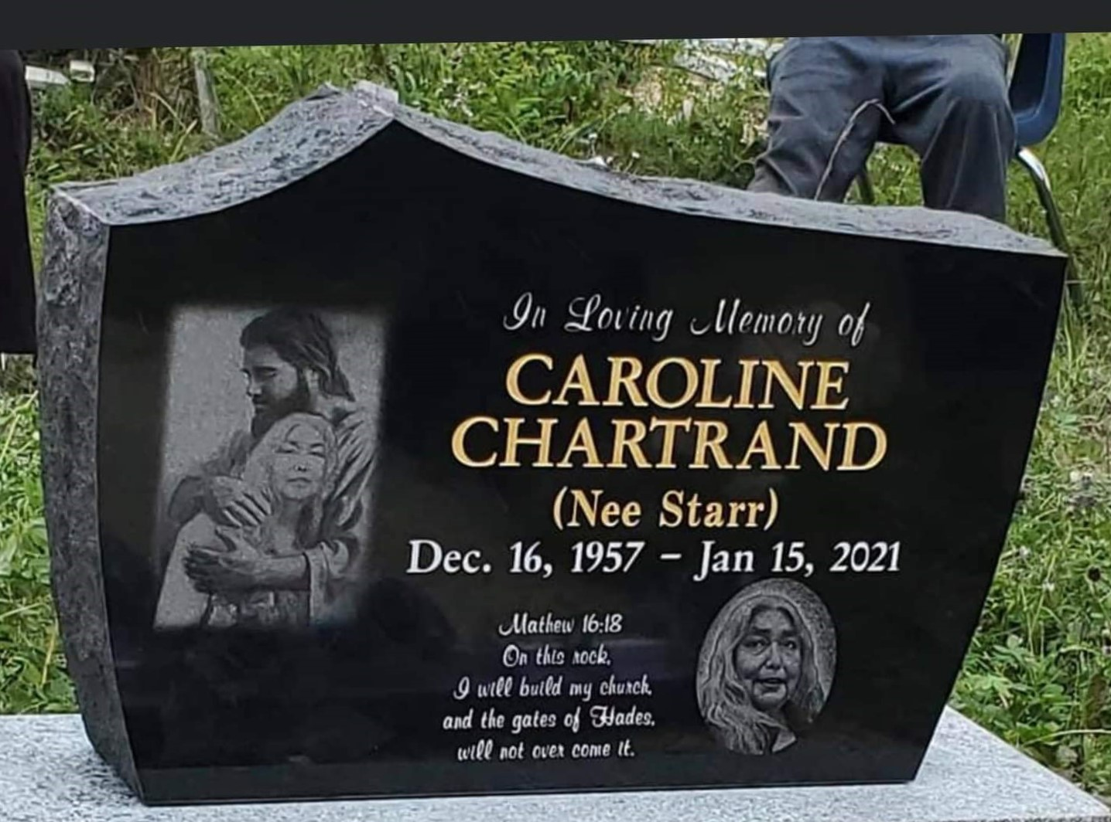
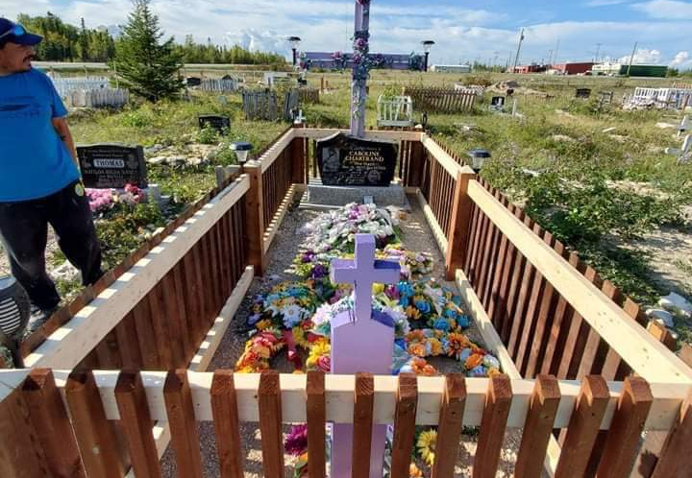
Grave of Caroline, on the reserve of the Chemawawin Cree Nation, Easterville, MB

Slide 12
Compound word construction in Swampy Cree
Anglican (or English) priest:
  Akenasêwemakimow (makimow = prayer boss)
Bishop:
  Che-makimow – (the big prayer boss)

