Slide 1
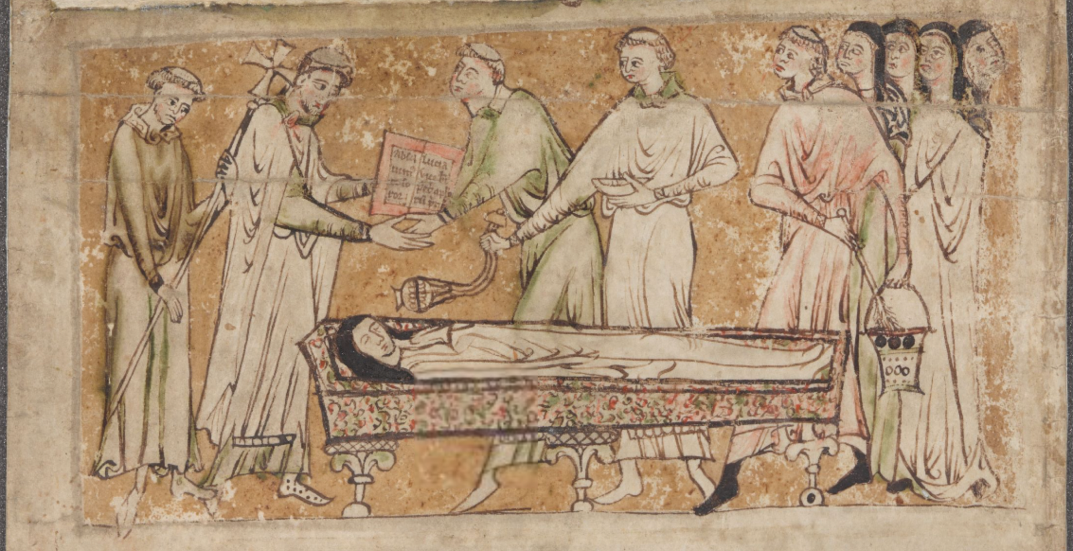
Participating in the Past:
An Ethnographic Approach to Medieval Liturgical Practices
Katie Ann-Marie Bugyis
Program of Liberal Studies
University of Notre Dame
kbugyis@nd.edu
London, British Library, Egerton MS 2849

Slide 2
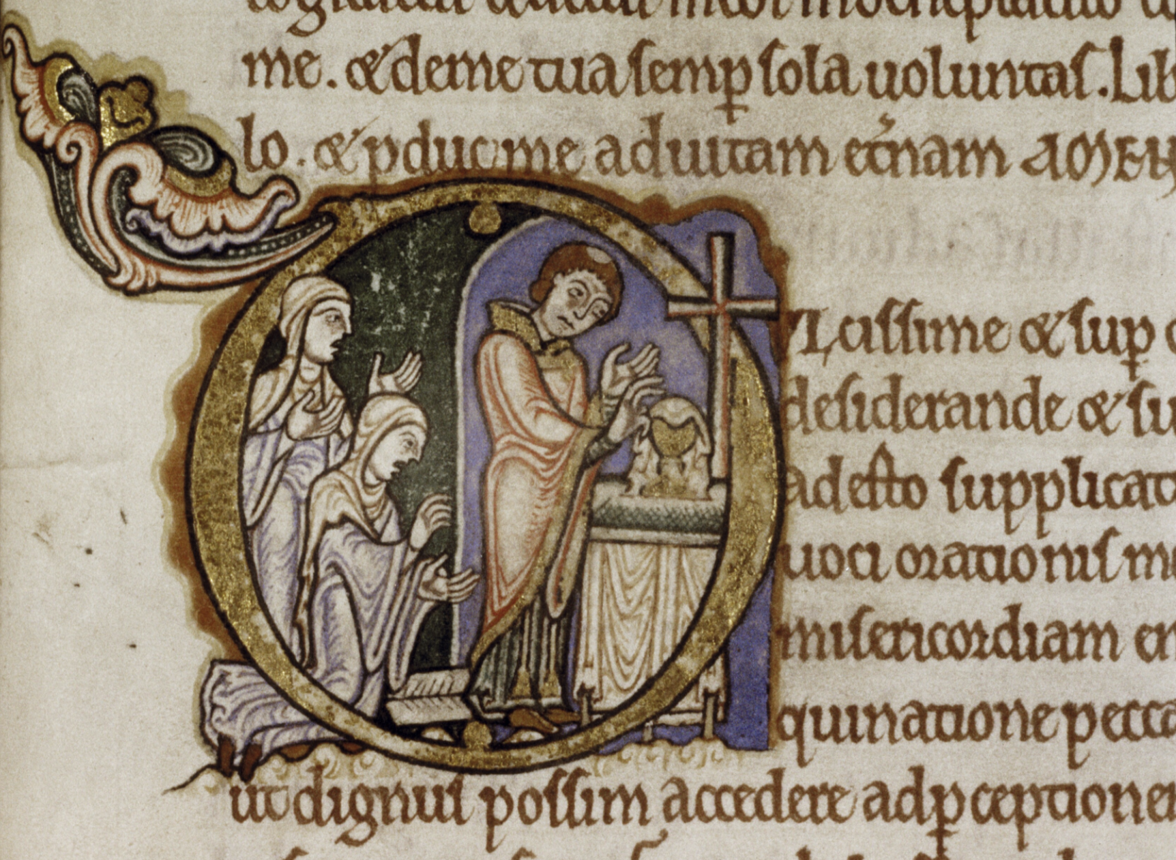
The Matter of Liturgy in Benedictine Women’s Communities in Medieval England

Slide 3
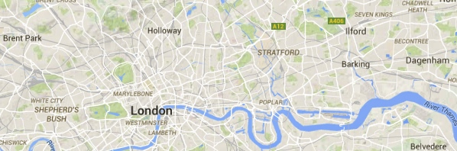
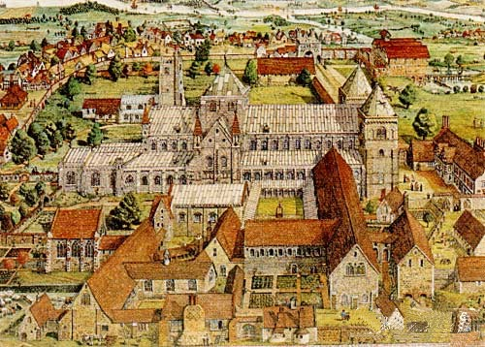
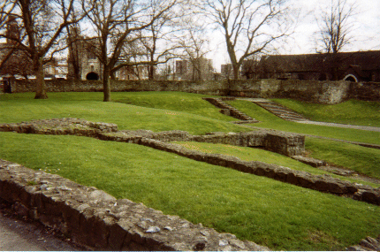
Barking Abbey
Barking Abbey in c. 1500
Remains of Barking Abbey Today

Slide 4
Shelfmark | Type | Date
olim Beeleigh Abbey, Foyle MS, now in private ownership | Nicholas Love, Mirror of the Blessed Life of Jesus Christ; William Flete’s De remediis contra temptationes | s. xv^{in}
Cambridge, Trinity College, MS O.3.54 (1226) | Hymnal | s. xv
Cambridge, University Library, MS Dd.12.56 | Book of Hours | s.xv
Cardiff, Public Library, MS 1. 381 | Collection of saints’ lives | s. xii^{in-med}
Cardiff, Public Library, MS 3. 383 | Defensor of Ligugé, Scintillarium; anonymous theological treatises; John Beleth, Summa de ecclesiasticis officiis; Summa de vitiis et virtutibus | s. xiii^{ex}
Dublin, Trinity College, MS 176 | Collection of saints’ lives | s. xi^{2/2} and xii^{1/2}
London, British Library, Additional MS 10596 | Wycliffite translation of the Book of Tobit, the Book of Susanna, and the Magnificat and Benedictus | s. xv
London, British Library, Cotton MS Julius D. viii, fols. 40r-47v | Accounts of Barking’s Cellaress | after 1453
London, British Library, Cotton MS Otho A. v | Calendar and explanation in English | s. xiv^{ex}
London, Lambeth Palace, 1495.4 (printed book) | Vitas patrum in English printed by Wynkyn de Worde, Westminster | 1495
Nijmegen, University Library, MS 194, fols. 41-104 | Collection of prayers and devotional materials | s. xv
Oxford, Bodleian Library, MS Bodley 155 | Gospel book | s. xi^{in}
Oxford, Bodleian Library, MS Bodley 923 | Clensyng of Mannes Sowle | s. xiv^{med}
Oxford, Bodleian Library, MS Laud lat. 19 | Song of Songs with gloss; Lamentations with gloss | s. xii
Oxford, Magdalen College, MS lat. 41 | Large collection of devotional and moral works in French | s. xv
Oxford, University College, MS 169 | Ordinal | c. 1404
Paris, Bibliothèque nationale de France, ms fr. 1038 | Vies des pères and other devotional texts in French | s. xiii/xiv

Slide 5
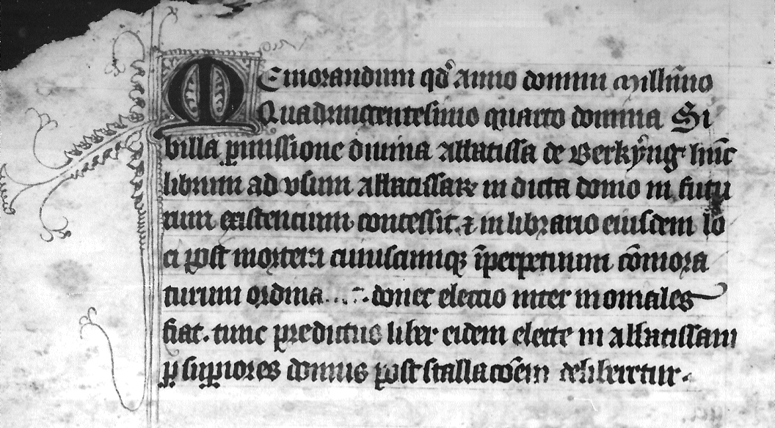
The Barking Ordinal
Oxford, University College, MS 169, fol. 2v
Abbess Sibyl de Felton’s memorandum concerning the ordinal’s future use

Slide 6
Barking Abbey
Barking Abbey in c. 1500
Remains of Barking Abbey Today

Slide 7
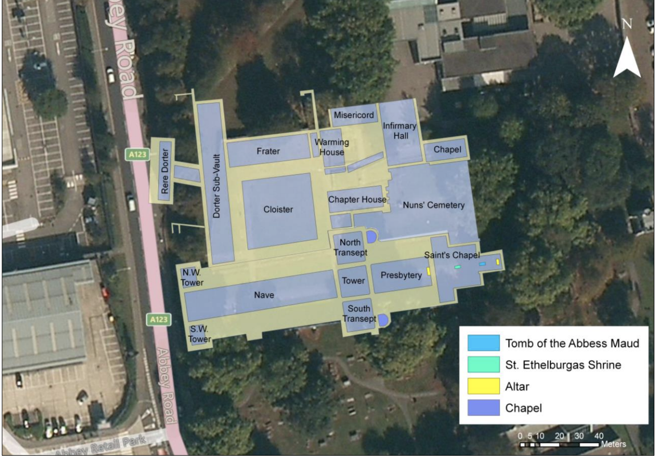
GIS Map of Barking Abbey
Donna Bussell and Joseph McNamara, “Barking Abbey: A GIS Map of a Medieval Nunnery,” Peregrinations 4:1 (2013): 173-189.

Slide 8
Robert Orsi, The Madonna of 115th Street:
Faith and Community in Italian Harlem, 1880-1950
“The precise configuration of the relation between the present and the past is not inherent in the nature of history but is constituted by historians and others engaged in the work of remembering (and forgetting) as they tell stories and write histories out of the needs, desires, and fears of their present circumstances. Even the pastness of the past—the quality of its being over, once and for all, that we tend to assume—is achieved, not given. The claim ‘oh, that’s ancient history’ is almost always a wish, an anxious attempt to put a boundary of time around some event that really is not over at all; it is a bid to silence the past” (x-xi).

Slide 9
Questions for Discussion
How can we, in our research methods and writing, recognize more fully the intersubjective grounds on which our understanding of the past is founded?
What is the where and when of our inquiries if not here and now or there and then?
Can we still call what we do liturgical history? Or must we call it something else?

